Slide 1

基于深度神经网络的谱聚类算法研究
DeepCluster on Attributed Graph
Changtong Zan
20191112
Notes:
大家好，我今天讲的内容是Self-supervised Clustering on Attributed Graph

Slide 2
Content
01 Attributed graph
02 Deep Cluster
03 Our work
04 Problems
工作进度计划
Notes:
主要包括这四个部分，我先简单介绍一下我要说的内容，再说一下我对谱聚类还有SpectralNet的学习情况。最后是我接下来打算做什么。

Slide 3
01
Attributed graph
Notes:
首先是简要介绍部分

Slide 4
Attributed graph
What is Attributed graph？
Attributed graph are the graph where each node is associated with a set of feature attributes.
Why do we care？
Attributed graphs widely exit in real-world applications such as citation networks, social networks, etc.

Slide 5
Attributed graph
Excepted challenge of attributed graph:
attributed graph clustering requires joint modelling of graph structures and node attributes to make full use of available data, which presents great challenges.
Notes:
这里说现在效果最好的是基于GCN的聚类方法

Slide 6
02
DeepCluster
Notes:
接下来我讲一下谱聚类

Slide 7
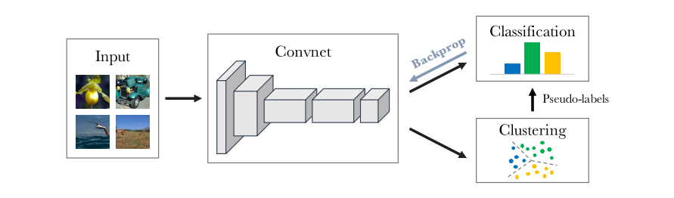
DeepCluster
DeepCluster iteratively groups the features with a standard clustering algorithm, k- means, and uses the subsequent assignments as supervision to update the weights of the network.
Caron, Mathilde, et al. "Deep clustering for unsupervised learning of visual features." Proceedings of the European Conference on Computer Vision (ECCV). 2018.
Notes:
首先是谱聚类的核心Laplacian矩阵，Lsym是对称矩阵，Lrw跟随机游走有很大关系

Slide 8
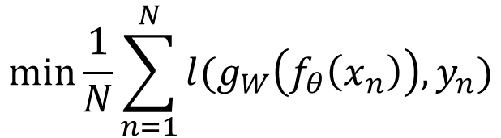
DeepCluster
The parameters W of the classifier and the parameter θ of the mapping are then jointly learned by optimizing the following problem：
$$min\frac{1}{N}\sum_{n=1}^{N}{l(g_{W}\left(f_{θ}\left(x_{n}\right)\right),y_{n})}$$
where ℓ is the multinomial logistic loss.
Notes:
Spectral clustering与k-means的区别：避免了NP-hard问题，不会陷入局部最小。
Spectral clustering引入了非线性变换，解决了线性变换无法获得好的可分性的问题。

Slide 9
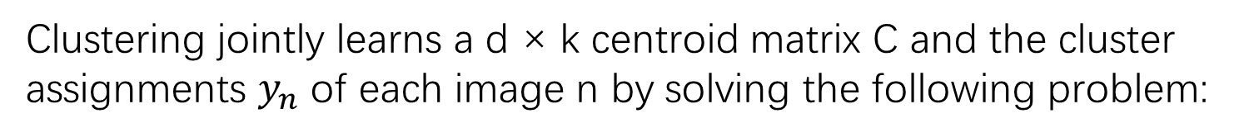
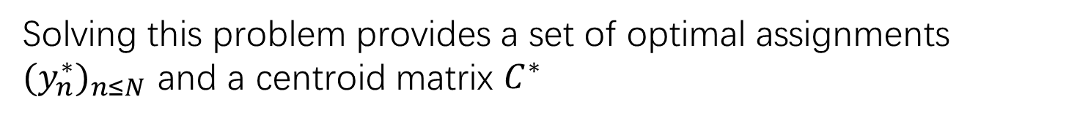
DeepCluster
Clustering jointly learns a d × k centroid matrix C and the cluster assignments $y_{n}$ of each image n by solving the following problem:
$\min_{CεR^{d × k}}{\frac{1}{N}\sum_{n=1}^{N}{{\min_{y_{n}ε{\{0,1\}}^{k}}\left\|f_{θ}\left(x_{n}\right)−Cy_{n}\right\|}^{2} }}$such that ${y_{n}}^{T}1_{k}=1$
Solving this problem provides a set of optimal assignments ${(y_{n}^{∗})}_{n≤N}$ and a centroid matrix $C^{∗}$
Notes:
Spectral clustering与k-means的区别：避免了NP-hard问题，不会陷入局部最小。
Spectral clustering引入了非线性变换，解决了线性变换无法获得好的可分性的问题。

Slide 10
DeepCluster
Initialize the CNN
repeat：
1) extract features from each sample and run K-means algorithm in feature space
2) train CNN in a supervised mode with the Pseudo labels(1 epoch)

Slide 11
03
Our work

Slide 12
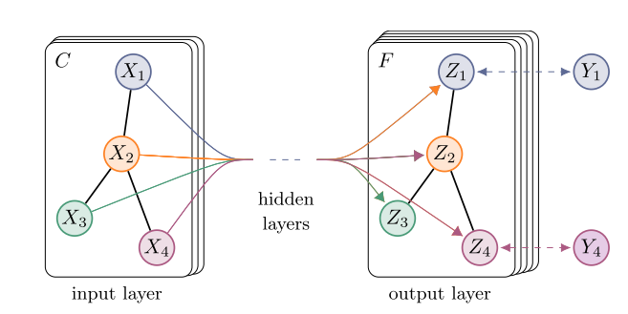

Our work
The work is introduce the GCN to Learning by clustering
Graph Convolution Network：
$Z=D^{−\frac{1}{2}}A$ $D^{−\frac{1}{2}}XΘ$
Kipf, Thomas N., and Max Welling. "Semi-supervised classification with graph convolutional networks." arXiv preprint arXiv:1609.02907 (2016).

Slide 13
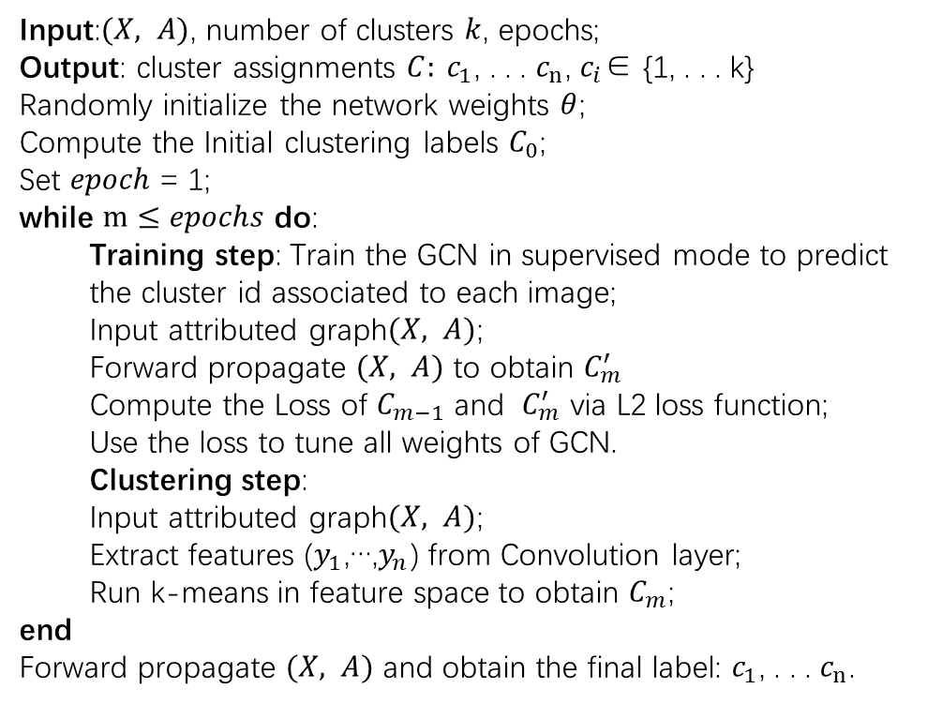
DeepCluster
Input:$(X, A)$, number of clusters $k$, epochs;
Output: cluster assignments $C: c_{1}$, . . . $c_{n}$, $c_{i}$∈ {1, . . . k}
Randomly initialize the network weights $θ$;
Compute the Initial clustering labels $C_{0}$;
Set $epoch$= 1;
while $m≤epochs$ do:
Training step: Train the GCN in supervised mode to predict the cluster id associated to each image;
Input attributed graph$(X, A)$;
Forward propagate $(X, A)$ to obtain $C_{m}^{′}$
Compute the Loss of $C_{m−1}$ and $C_{m}^{′}$ via L2 loss function;
Use the loss to tune all weights of GCN.
Clustering step:
Input attributed graph$(X, A)$;
Extract features ($y_{1}$,…,$y_{n}$) from Convolution layer;
Run k-means in feature space to obtain $C_{m}$;
end
Forward propagate $(X, A)$ and obtain the final label: $c_{1}$, . . . $c_{n}$.

Slide 14
04
Problems

Slide 15
Problems
1. Empty clusters
2. Clustering most samples into one cluster
3. Lack of effective initialization
…

Slide 16
Thanks

